Slide 1
Energetic compensation breaks down over time in a desert rodent community
Renata M. Diaz and S. K. Morgan Ernest
ESA Annual Meeting, August 2021

Slide 2

Energetic compensation: decreases in abundance of one species are offset by increases from others, so total energy use is maintained.
Notes:
Explain hypothetical scenario
Consistent with zero-sum competition
By definition means community function is more stable than species

Slide 3
Energetic compensation: decreases in abundance of one species are offset by increases from others, so total energy use is maintained.
When is absent, increases in abundance to use 100% of the energy left unused by .
An assemblage without uses the same amount of energy as the complete assemblage.
Notes:
Explain hypothetical scenario
Consistent with zero-sum competition
By definition means community function is more stable than species

Slide 4
When observed, energetic compensation is consistent with a zero sum competitive dynamic.
Energetic compensation renders community-level function less variable than individual species’ abundances.
Notes:
Explain hypothetical scenario
Consistent with zero-sum competition
By definition means community function is more stable than species

Slide 5
For energetic compensation to occur, some species must have identical or overlapping traits relating to both resource use and environmental tolerances.

Slide 6






Species are not identical but have overlapping resource use and environmental requirements.
Notes:
Explain hypothetical scenario
Consistent with zero-sum competition
By definition means community function is more stable than species

Slide 7


Species differ in their responses to varying environmental conditions.
Notes:
Explain hypothetical scenario
Consistent with zero-sum competition
By definition means community function is more stable than species

Slide 8
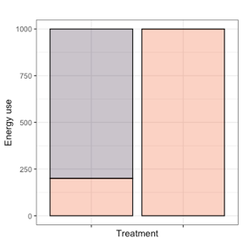
Changing conditions over time can affect the potential for compensation by shifting overall species composition.
Notes:
Explain hypothetical scenario
Consistent with zero-sum competition
By definition means community function is more stable than species

Slide 9
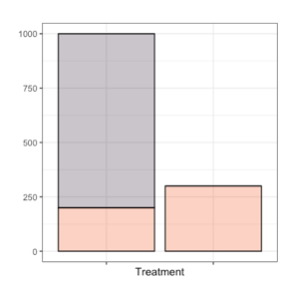
Changing conditions over time can affect compensation by limiting compensatory increases from sometimes-substitutable species.
Notes:
Explain hypothetical scenario
Consistent with zero-sum competition
By definition means community function is more stable than species

Slide 10
How does energetic compensation change as conditions change over time?

Slide 11
Long-term experiments: The Portal Project
Kangaroo rats
Excluded from experimental plots since 1977
Small granivores (mostly desert pocket mice)
Present since 1977
Bailey’s pocket mouse
Established at site ~1996

Slide 12
Compensation occurred beginning in 1996, driven by C. baileyi ( )
1977 - 1996
1996 - ?

Slide 13
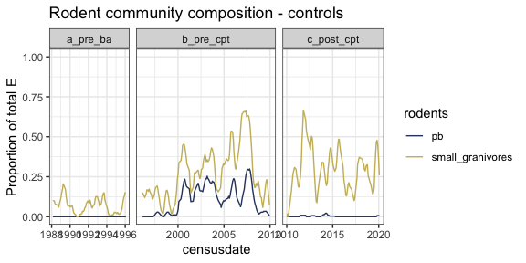
Shifting environmental conditions have transformed the rodent community

Slide 14
How have these changes impacted energetic compensation?

Slide 15
Other small granivores may now be compensating, in place of C. baileyi
1996 - 2010
Hypothetical 2010-2020

Slide 16
Or, compensation may have broken down.
1996 - 2010
Hypothetical 2010-2020

Slide 17
Since 2010, compensation has declined to pre-1996 levels.

Slide 18
Compensation depends not only on the species present but on their match to current environmental conditions.
As conditions change, compensation may come and go within a single assemblage.

Slide 19
Zero-sum competitive dynamics may be intermittent and contingent on changing conditions.
Maintenance of community-level function given species loss may depend on remaining or new species tracking environmental change.

Slide 20
Thank you, and I look forward to any questions!

Slide 21
Acknowledgements
NSF funding
UF
Portal Project folks

